Slide 1
Digital systems
Hardware components – you can see and touch these
Software - programs on the computer

Slide 2
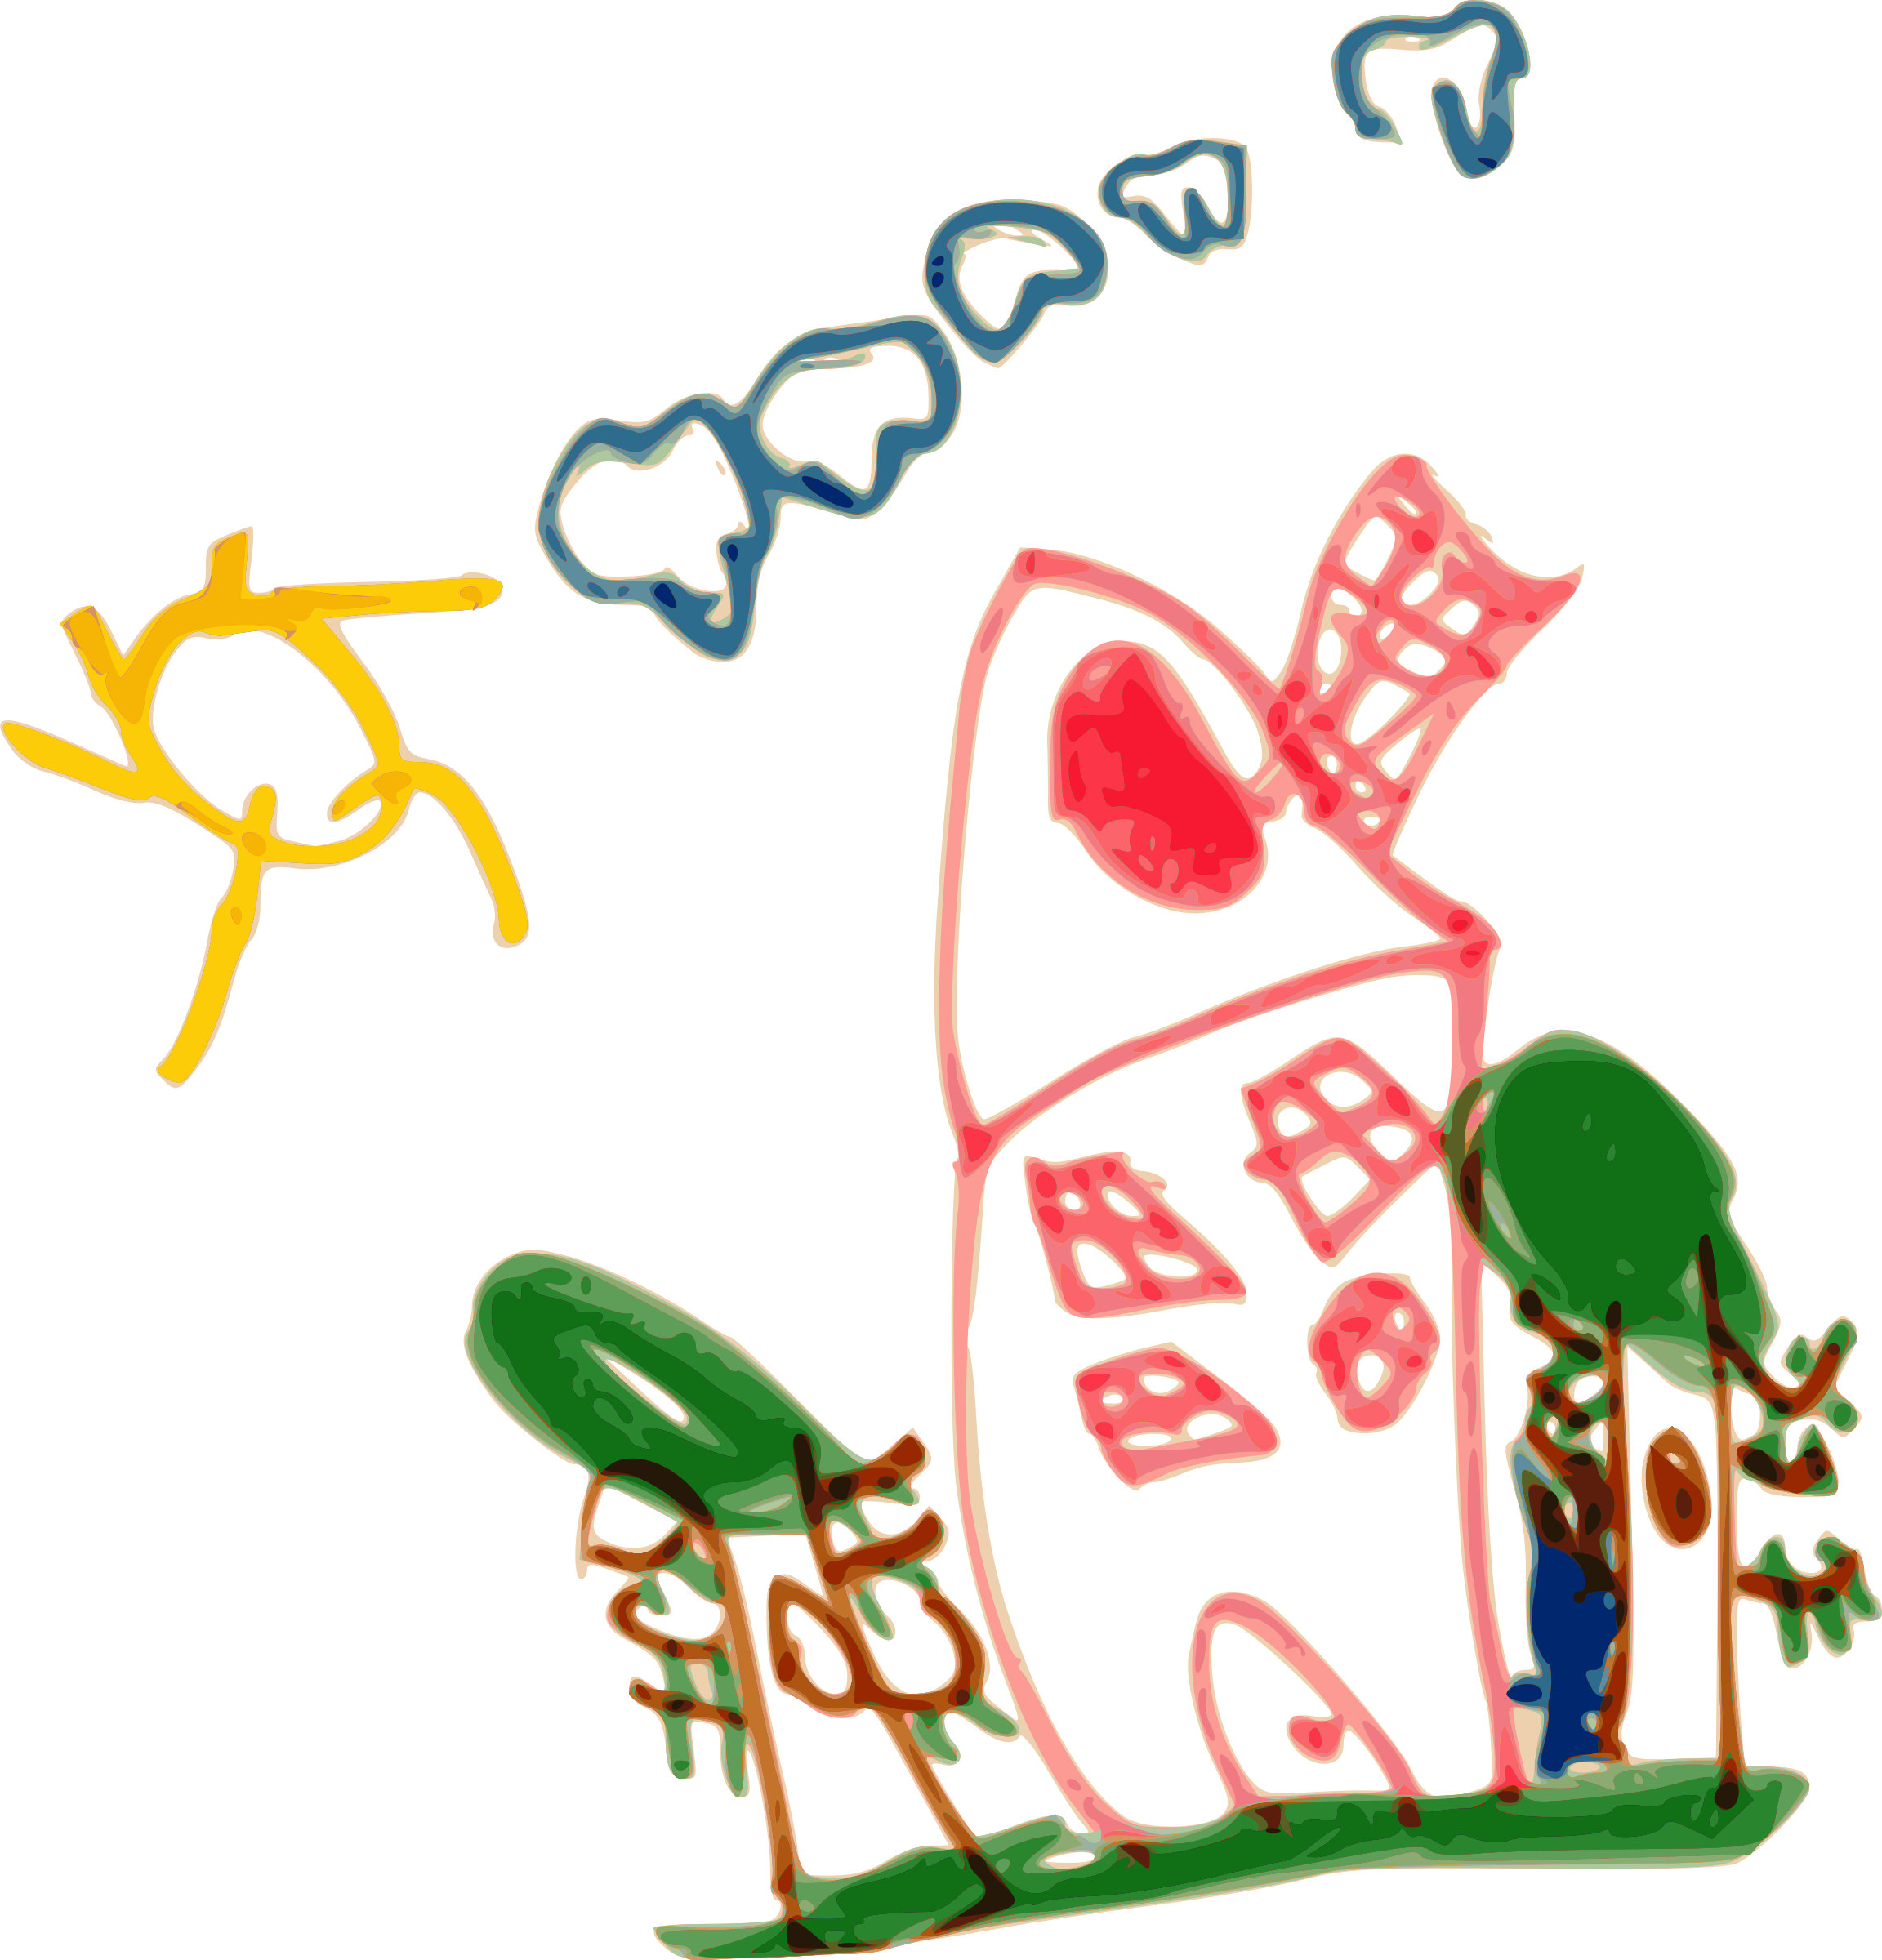
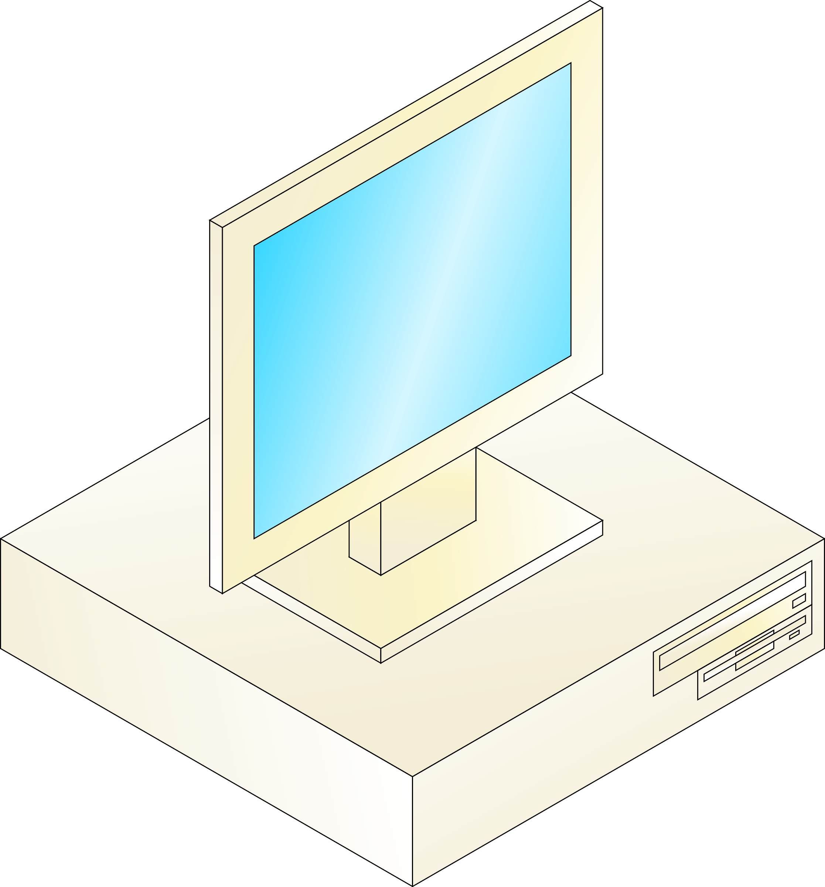
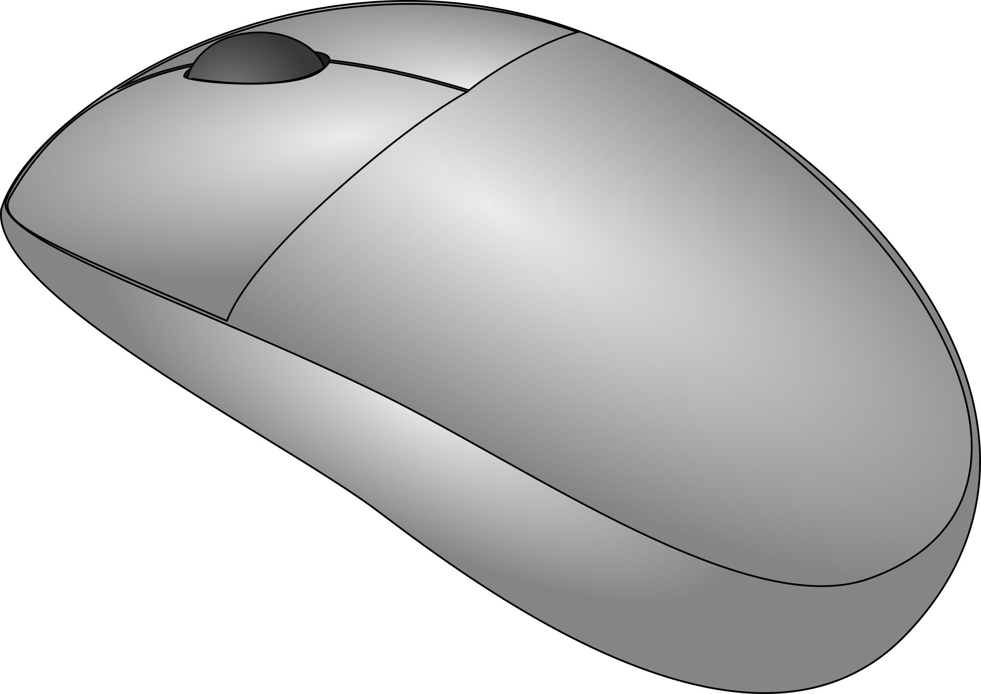
Look at the pictures. Think. Is this software or hardware?

Slide 3
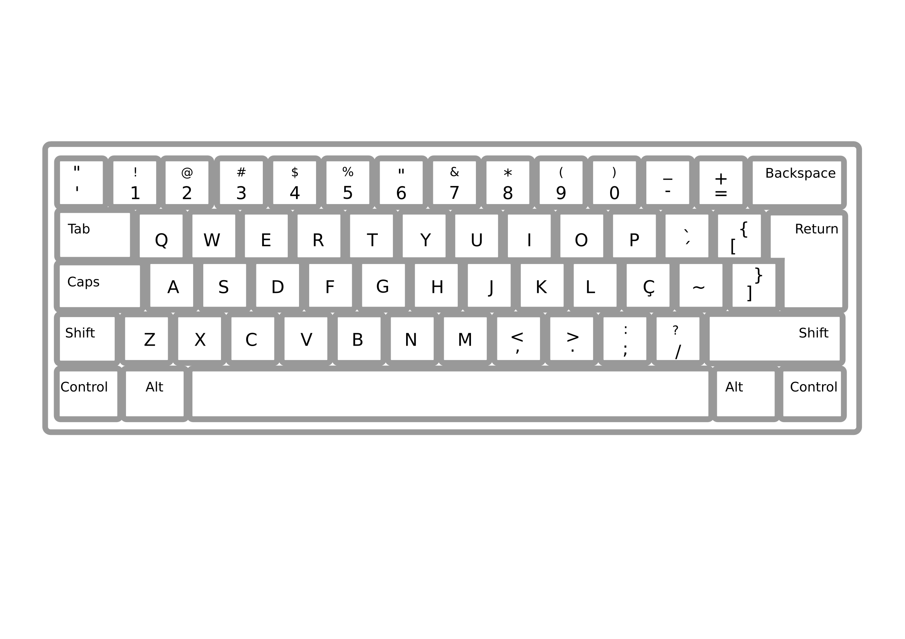
Look at the pictures. Think. Is this software or hardware?

